Slide 1

CPU Scheduling
PASS: well done!
CS532: OS Foundations
Lab Assignment
email address: parth2@pdx.edu
partner’s email address:

Slide 2
Instructions: Make a copy of this document, move your copy to your submissions folder and fill the document with your responses. Use the space on each slide to show your responses, and add additional slides as needed.
When ready for grading: complete the lab assignment submission form and include a link to your filled document

Slide 3
scheduler.py
Go to the cpu-sched sub-directory within your ostep-homework directory on linux.cs.pdx.edu, and read the Readme.md file. Read this file thoroughly and try every example shown there. The scheduler.py program in this sub-directory allows you to measure and compare various scheduling algorithms using metrics such as response time, turnaround time and total wait time.
Use scheduler.py to help answer each of the questions in this assignment.

Slide 4
1. Compute the response time and turnaround time when running three jobs of length 400 with the SJF and FIFO schedulers
 | Response time | Turnaround Time
SJF
FIFO
Answer in the next few slides

Slide 5
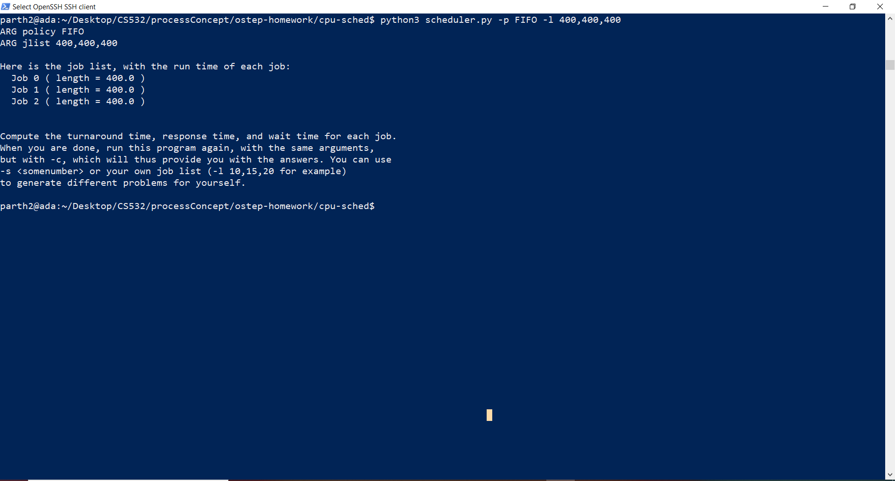
First we will execute the FIFO scheduling algorithm as below:-

Slide 6
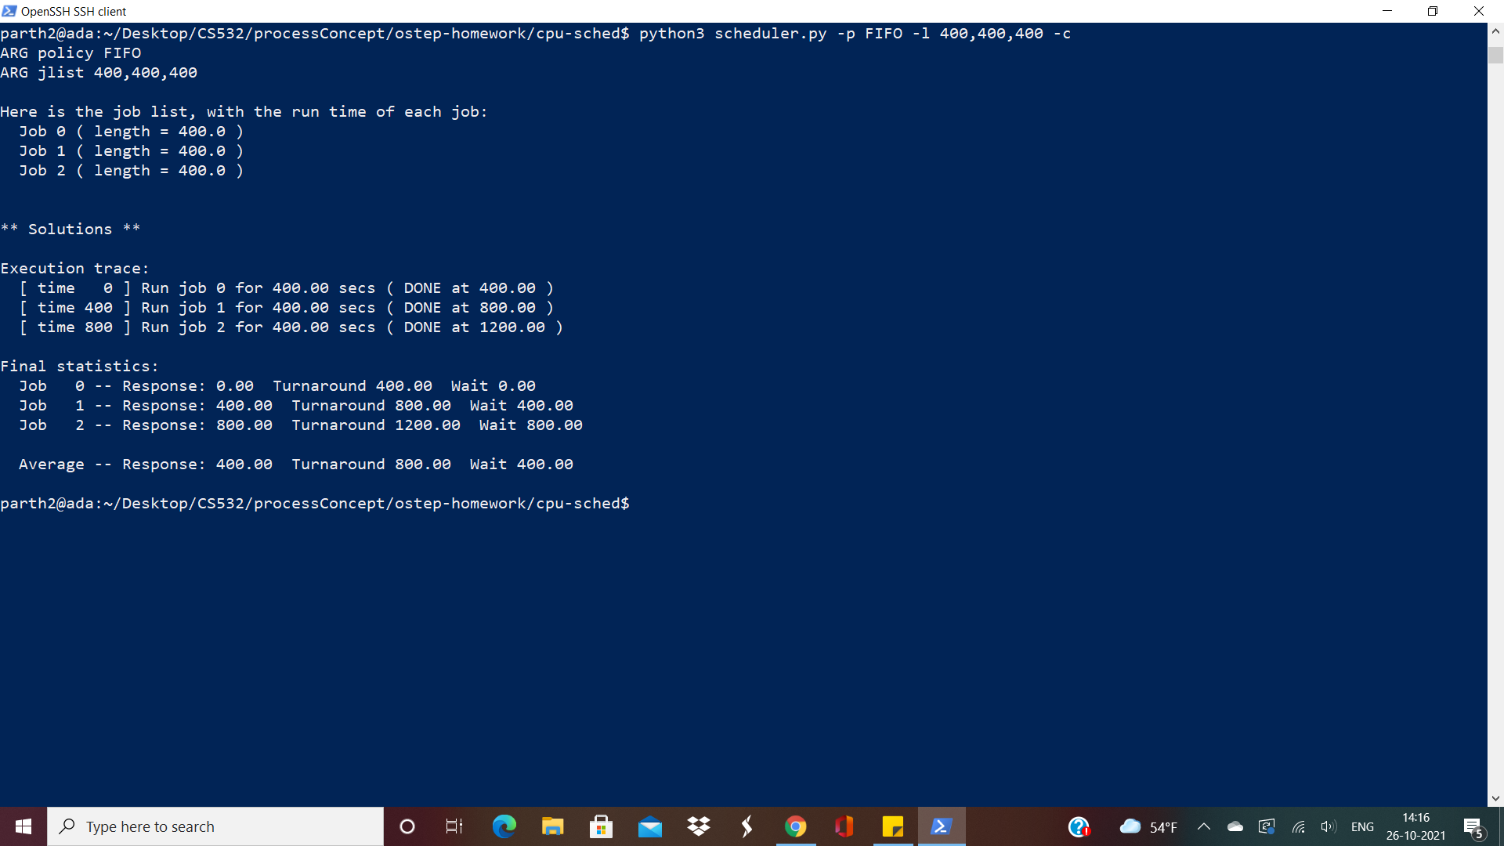

Slide 7
For the FIFO scheduling algorithm, we follow the steps mentioned below:-
The execution order for the processes using FIFO scheduling algorithm is First in and First executed. This means that the process which enters the process queue first will execute first and keep the CPU resources all to itself till the time it has not completed its execution
This is a non-preemptive scheduling algorithm.
Now for calculating the Response Time and Turnaround Time, We will see how the processes will start executing:-
a) Process 1 will start executing as soon as entering the queue. It will have a delay as well as response time of 0. The total turnaround time will stand at 400.
b) By the time Process 1 ends, Process 2 present in the process queue will enter the CPU and starts executing. This means that the process 2 will have a delay of 400 (as all process entered the process queue at the same time of CPU Clock 0) and a turnaround time of 800. Response time will stand at 400 as well.
c) As process 2 finishes execution at a total CPU clock of 800, Process 3 present in the process queue enters the CPU and starts executing its instructions. Hence the Delay will stand at 800 ((as all process entered the process queue at the same time of CPU Clock 0)) The Response time will be 800 as well whereas the total turnaround time will stand at 1200 .

Slide 8
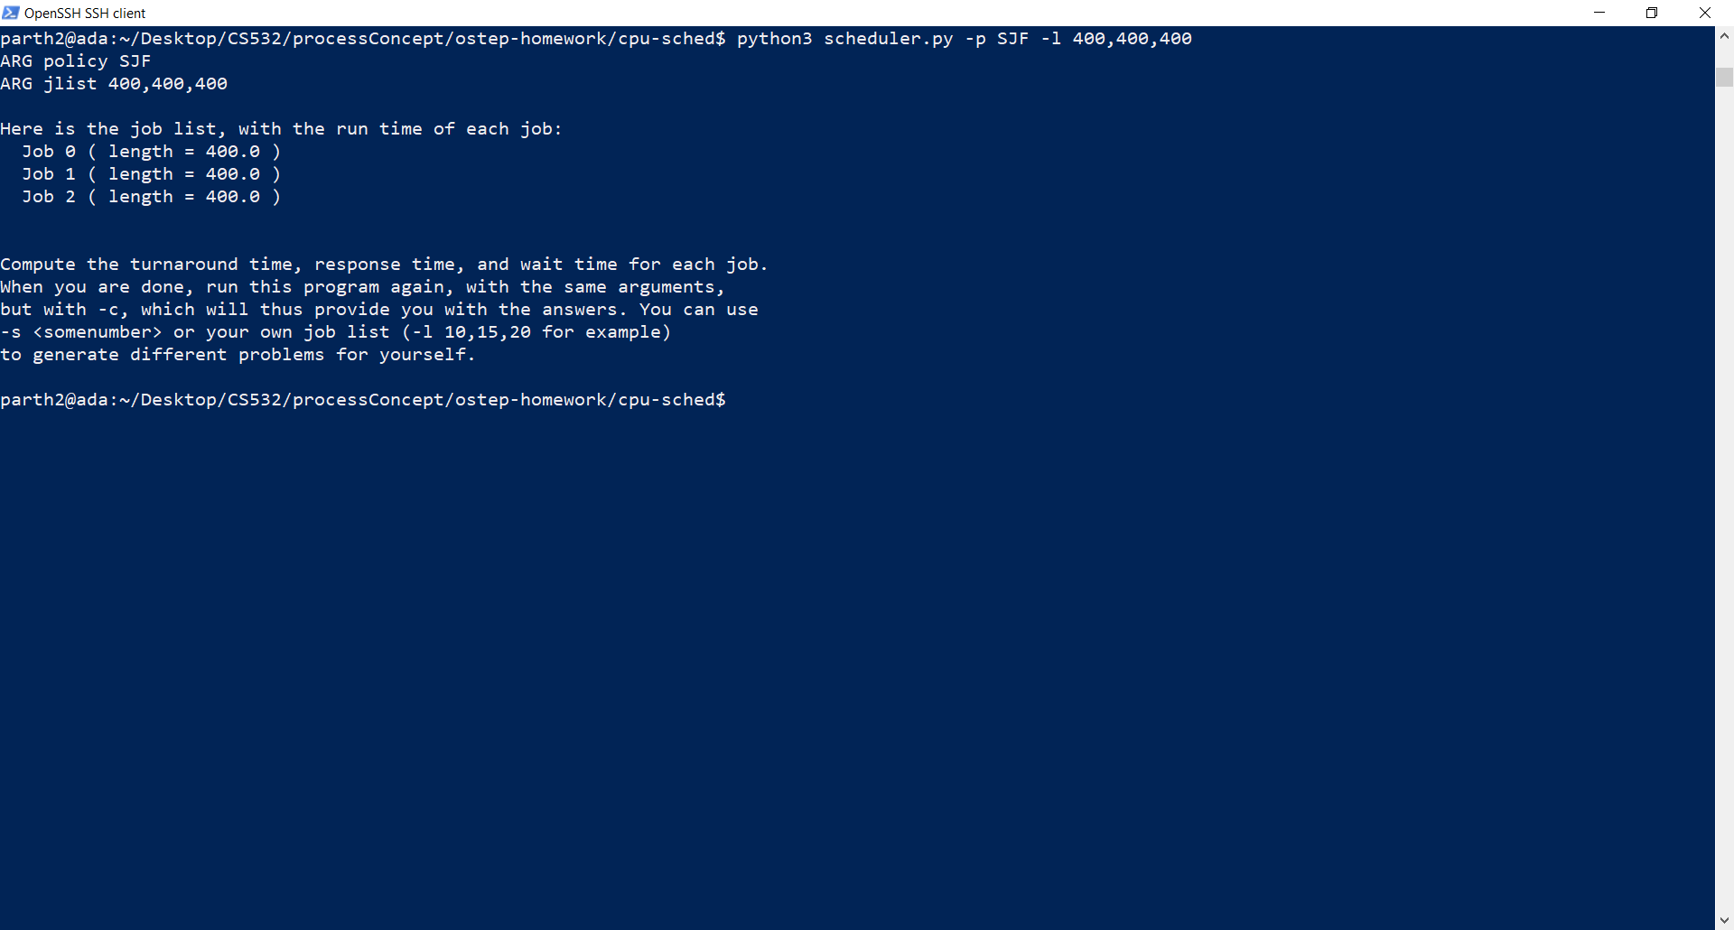
For the same process list, when SJF scheduling algorithm is applied, we get the following results:-

Slide 9
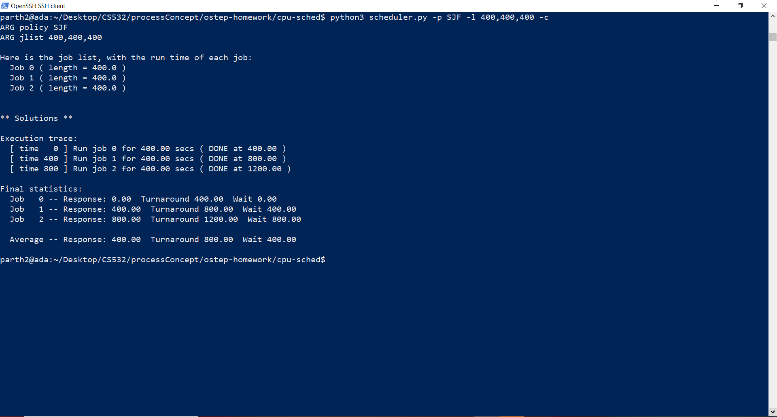

Slide 10
For the SJF scheduling algorithm, we follow the steps mentioned below:-
The execution order for the processes using SJF scheduling algorithm is that the process with the shortest running (processing) tim will be executed first.
This can be a preemptive or non-preemptive scheduling algorithm. Preemptive SJF is also known as Shortest Time Remaining scheduling algorithm.
Now for calculating the Response Time and Turnaround Time for our given example, we have,:-
As the Processes enter the process queue, the SJF will check the execution time for all the processes and will run the process which has the shortest time. Here, all the processes have the same running time, hence the processes will run in accordance with the order they have entered the process queue. In our scenario, we are using non-preemptive SJF.
Process 1 will start executing as soon as entering the queue. It will have a delay as well as response time of 0. The total turnaround time will stand at 400.
By the time Process 1 ends, Process 2 present in the process queue will enter the CPU and starts executing. This means that the process 2 will have a delay of 400 (as all process entered the process queue at the same time of CPU Clock 0) and a turnaround time of 800. Response time will stand at 400 as well.
As process 2 finishes execution at a total CPU clock of 800, Process 3 present in the process queue enters the CPU and starts executing its instructions. Hence the Delay will stand at 800 ((as all process entered the process queue at the same time of CPU Clock 0)) The Response time will be 800 as well whereas the total turnaround time will stand at 1200 .

Slide 11
For FIFO scheduling algorithm
Process id | Delay (Wait time) | Response Time | Turnaround time
Process 1 | 0 | 0 | 400
Process 2 | 400 | 400 | 800
Process 3 | 800 | 800 | 1200
For SJF Scheduling algorithm
Process id | Delay (Wait time) | Response Time | Turnaround time
Process 1 | 0 | 0 | 400
Process 2 | 400 | 400 | 800
Process 3 | 800 | 800 | 1200

Slide 12
The final results after performing the required experiments is given below:-
Algorithm | Average Wait Time | Average Response Time | Average Turnaround Time
SJF | 400 | 400 | 800
FIFO | 400 | 400 | 800

Slide 13
2. Now do the same but with jobs of different lengths: 300, 500, and 700.
Answers in the next slides

Slide 14
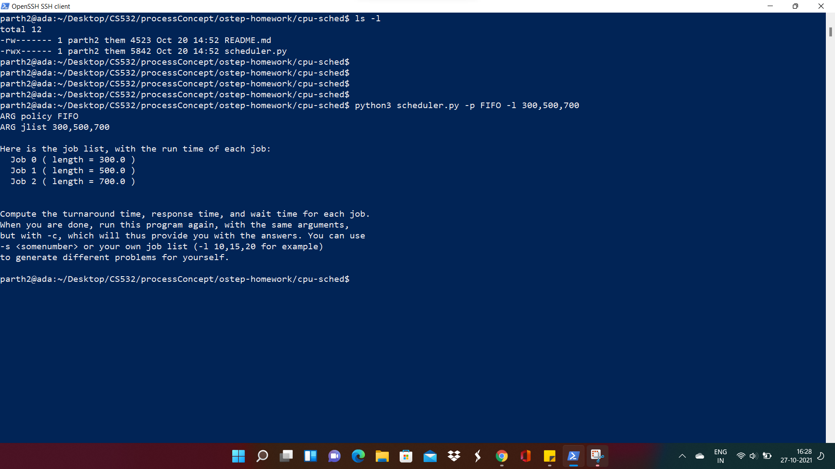

Slide 15
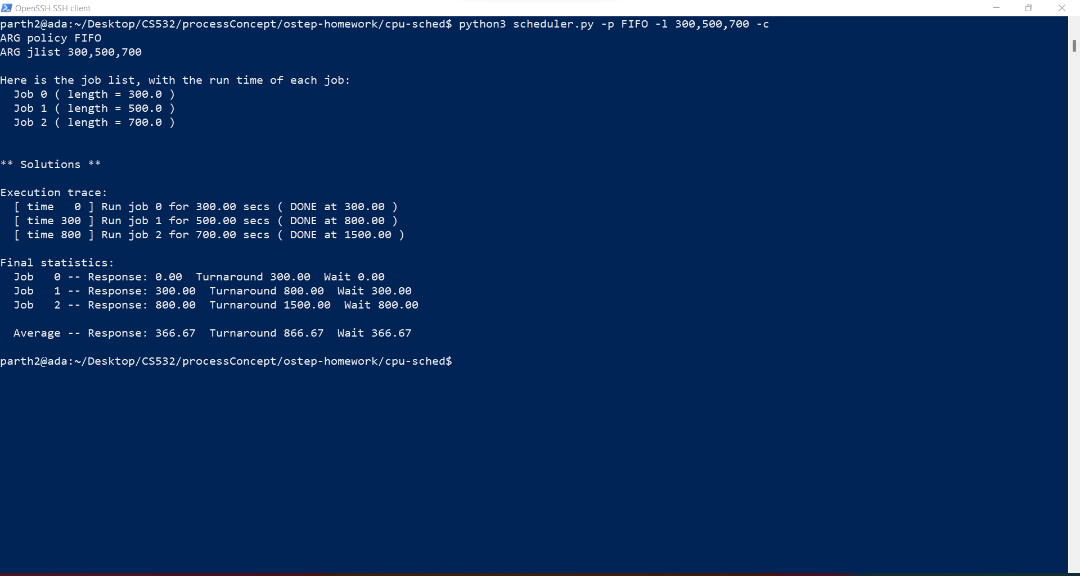

Slide 16
For the FIFO scheduling algorithm, we follow the steps mentioned below:-
The execution order for the processes using FIFO scheduling algorithm is First in and First executed. This means that the process which enters the process queue first will execute first and keep the CPU resources all to itself till the time it has not completed its execution
This is a non-preemptive scheduling algorithm.
Now for calculating the Response Time and Turnaround Time, We will see how the processes will start executing:-
a) Process 1 will start executing as soon as it enters the process queue. It will have a delay as well as response time of 0. The total turnaround time will stand at 300.
b) By the time Process 1 ends, Process 2 present in the process queue will enter the CPU and starts executing. This means that the process 2 will have a delay of 300 (as all process entered the process queue at the same time of CPU Clock 0) and a turnaround time of 500. Response time will stand at 300 as well.
c) As process 2 finishes execution at a total CPU clock of 800, Process 3 present in the process queue enters the CPU and starts executing its instructions. Hence the Delay will stand at 800 ((as all process entered the process queue at the same time of CPU Clock 0)) The Response time will be 800 as well whereas the total turnaround time will stand at 1500 .

Slide 17
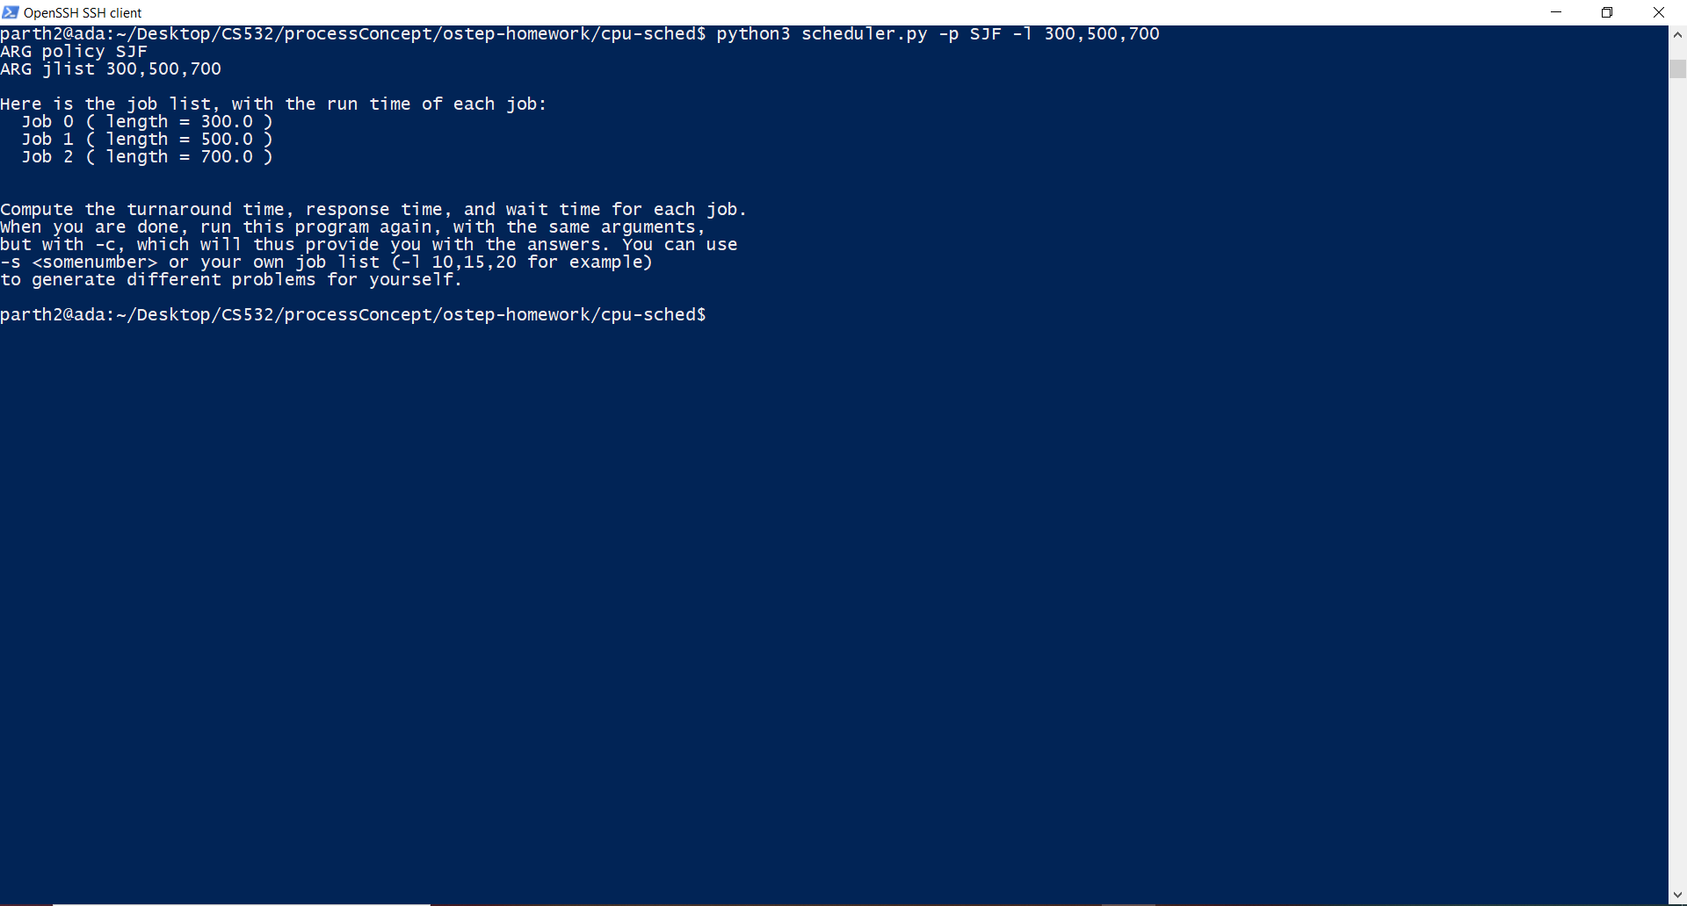

Slide 18
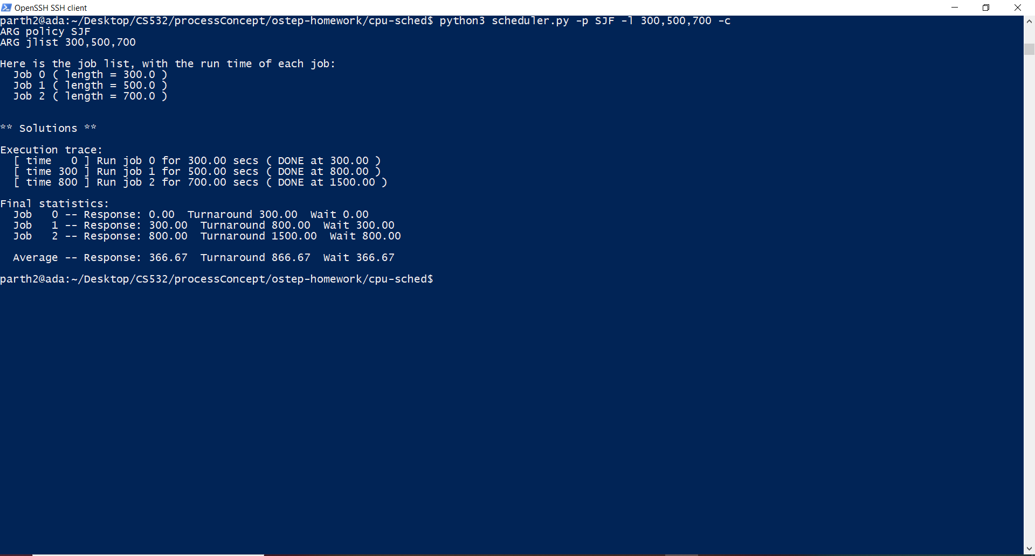

Slide 19
For the SJF scheduling algorithm, we follow the steps mentioned below:-
The execution order for the processes using SJF scheduling algorithm is that the process with the shortest running (processing) tim will be executed first.
This can be a preemptive or non-preemptive scheduling algorithm. Preemptive SJF is also known as Shortest Time Remaining scheduling algorithm.
Now for calculating the Response Time and Turnaround Time for our given example, we have,:-
As the Processes enter the process queue, the SJF will check the execution time for all the processes and will run the process which has the shortest time. Here, all the processes have the same running time, hence the processes will run in accordance with the order they have entered the process queue. In our scenario, we are using non-preemptive SJF.
Process 1 will start executing as soon as entering the queue. It will have a delay as well as response time of 0. The total turnaround time will stand at 300.
By the time Process 1 ends, Process 2 present in the process queue will enter the CPU and starts executing. This means that the process 2 will have a delay of 300 (as all process entered the process queue at the same time of CPU Clock 0) and a turnaround time of 800. Response time will stand at 300 as well.
As process 2 finishes execution at a total CPU clock of 800, Process 3 present in the process queue enters the CPU and starts executing its instructions. Hence the Delay will stand at 800 ((as all process entered the process queue at the same time of CPU Clock 0)) The Response time will be 800 as well whereas the total turnaround time will stand at 1500 .

Slide 20
For FIFO scheduling algorithm
Process id | Delay (Wait time) | Response Time | Turnaround time
Process 1 | 0 | 0 | 300
Process 2 | 300 | 300 | 800
Process 3 | 800 | 800 | 1500
For SJF Scheduling algorithm
Process id | Delay (Wait time) | Response Time | Turnaround time
Process 1 | 0 | 0 | 300
Process 2 | 300 | 300 | 800
Process 3 | 800 | 800 | 1500

Slide 21
The final results after performing the required experiments is given below:-
Algorithm | Average Wait Time | Average Response Time | Average Turnaround Time
SJF | 366.67 | 366.67 | 886.67
FIFO | 366.67 | 366.67 | 886.67

Slide 22
3. Now do the same, but also with the RR scheduler and a time-slice of 2.
Answer in the next slides

Slide 23
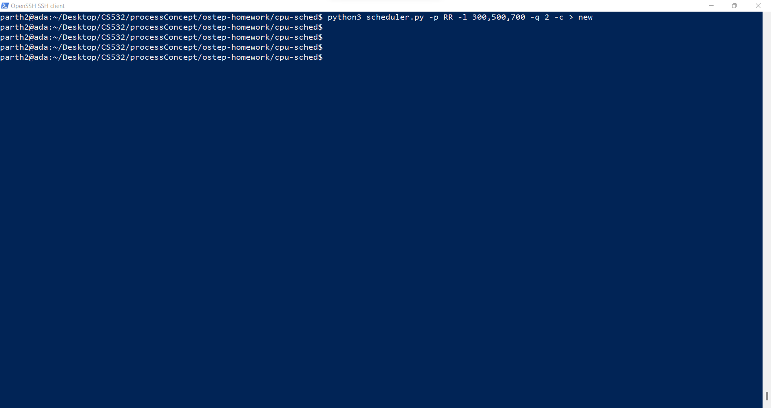

Slide 24
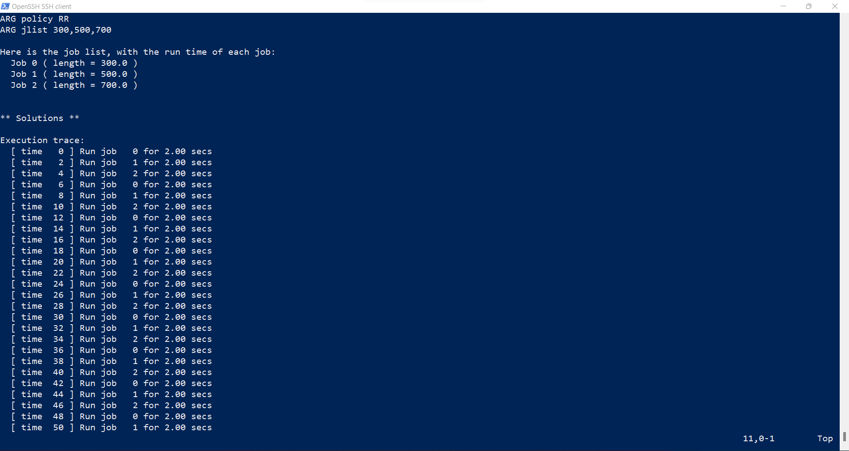

Slide 25
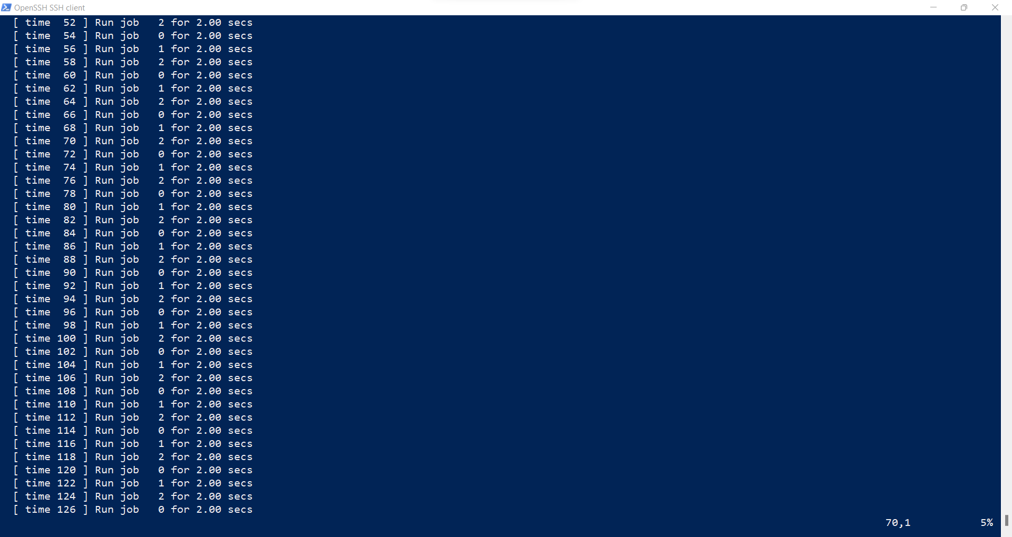

Slide 26
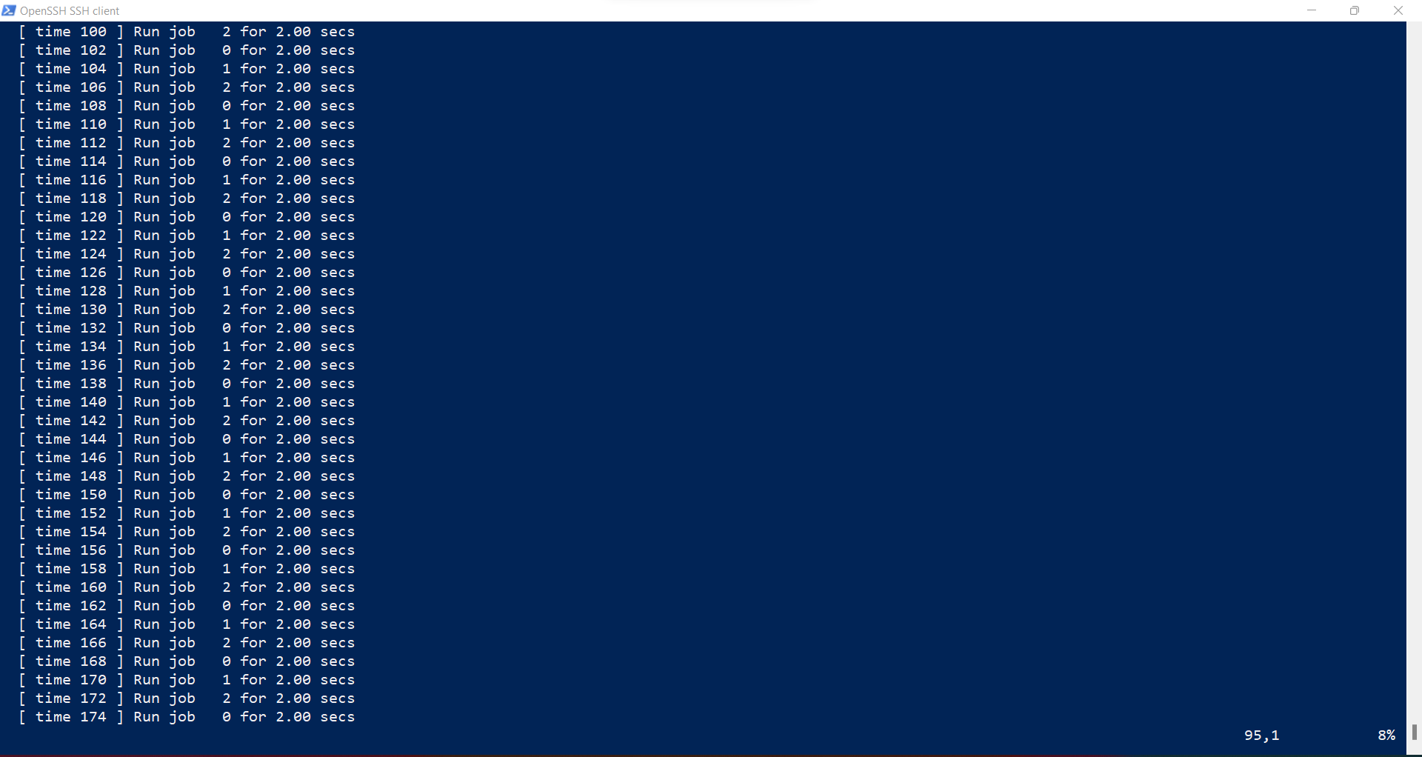

Slide 27
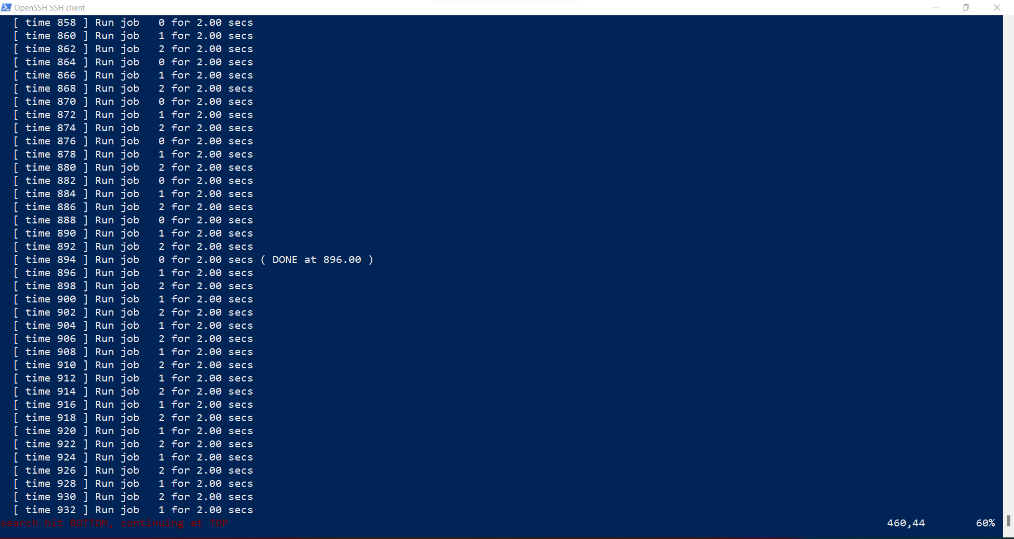
Like this, CPU will keep on executing the process 0,1,2 in this order for a time slice of 2 CPU ticks and will reach the following statistics as mentioned in the next few screenshots: -
Process 0 finished at 896.0

Slide 28
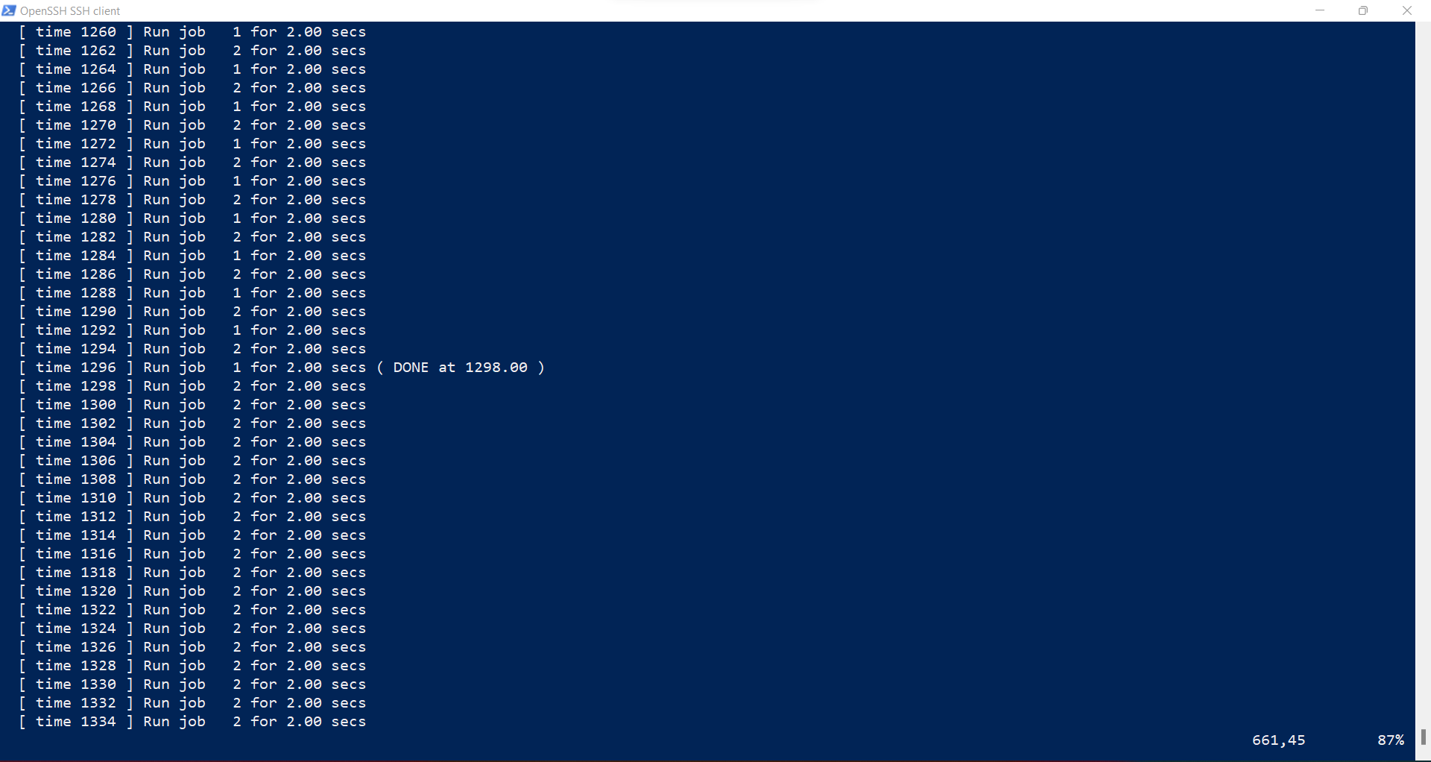
Process 1 finished executing at 1296.0

Slide 29
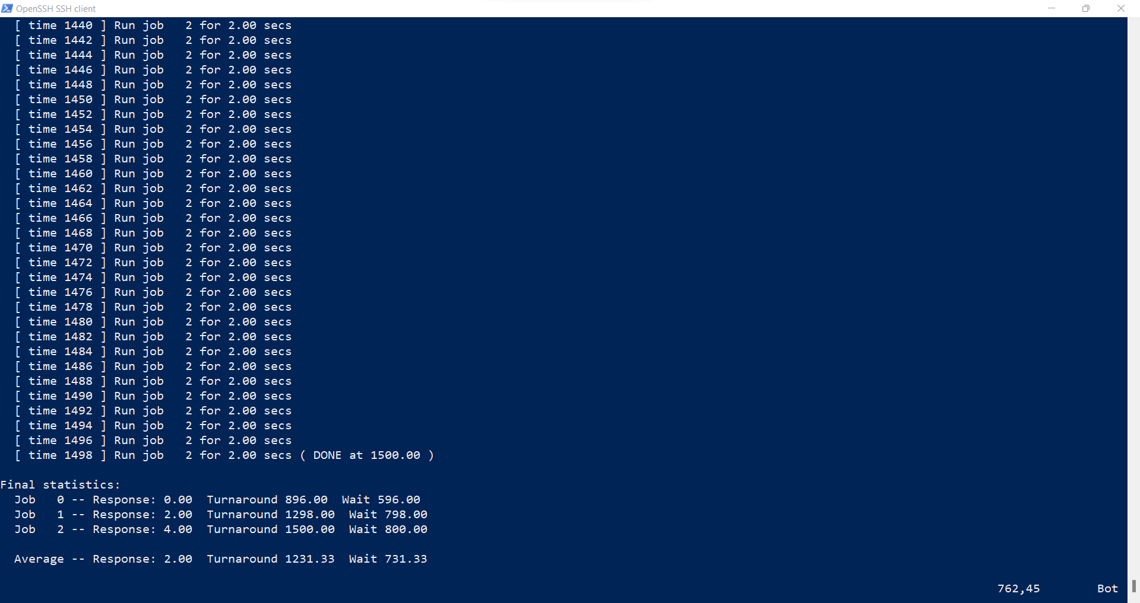
Process 2 completed at 1500.0

Slide 30
For the RR scheduling algorithm, we follow the steps mentioned below:-
The execution order for the processes using RR scheduling algorithm is that processes present in the process queue will have the CPU resources to them for a specific time interval after which the next process will be allocated the CPU resources for the same time interval.
Now for calculating the Response Time and Turnaround Time for our given example, we have,:-
As the Processes enter the process queue, the RR will check the execution time for all the processes and will run the process with the proper time frame (2 in our experiment) .
Process 1 will start executing as soon as it enters the process queue. It will be executed for the given time slice of 2 after which it will be pushed to the back of the process queue.
By the time Process 1 ends, Process 2 present in the process queue will enter the CPU and starts executing for the time slice of 2 after which the next process in the queue (process 3) will enter the CPU and start executing.
As process 2 finishes execution for 2 seconds, Process 3 present in the process queue enters the CPU and starts executing its instructions for a time slice of 2.
This cycle will continue until some of the processes finish their instructions to be executed after which they enter the DONE state and other processes of the queue will keep on continuing in the same fashion.

Slide 31
Process id | Delay (Wait time) | Response Time | Turnaround time
Process 1 | 596 | 0 | 896
Process 2 | 798 | 2 | 1298
Process 3 | 800 | 4 | 1500
Average Wait Time | Average Response time | Average Turnaround Time
731.33 | 2 | 1231.33

Slide 32
4. For what types of workloads does SJF deliver the same turnaround times as FIFO?
SJF will have the same turnaround time as FIFO when all of the processes in the process queue are of the same size. (eg: - 3 processes of same instruction size - 400 each enter the process queue)
SJF can also have the same turnaround time as FIFO when the jobs monotonically increase in size. (eg: - the shortest job arrives first, then the second shortest, then the third shortest and so on)
Good observations here

Slide 33
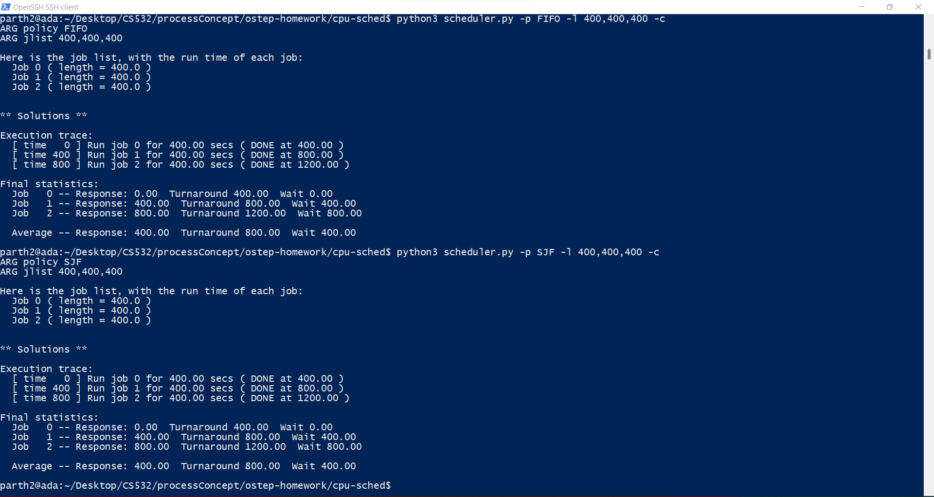

Slide 34
For FIFO scheduling algorithm with equal instruction lengths of all processes: -
python3 scheduler.py -p FIFO -l 400,400,400 -c
Process id | Delay (Wait time) | Response Time | Turnaround time
Process 1 | 0 | 0 | 400
Process 2 | 400 | 400 | 800
Process 3 | 800 | 800 | 1200
For SJF Scheduling algorithm with equal instruction lengths of all processes: -
python3 scheduler.py -p SJF -l 400,400,400 -c
Process id | Delay (Wait time) | Response Time | Turnaround time
Process 1 | 0 | 0 | 400
Process 2 | 400 | 400 | 800
Process 3 | 800 | 800 | 1200

Slide 35
The final results after performing the required experiments is given below:-
Algorithm | Average Wait Time | Average Response Time | Average Turnaround Time
SJF | 400 | 400 | 800
FIFO | 400 | 400 | 800

Slide 36


Slide 37
For FIFO scheduling algorithm with equal instruction lengths of all processes: -
python3 scheduler.py -p FIFO -l 400,400,400 -c
Process id | Delay (Wait time) | Response Time | Turnaround time
Process 1 | 0 | 0 | 200
Process 2 | 200 | 200 | 600
Process 3 | 600 | 600 | 1200
For SJF Scheduling algorithm with equal instruction lengths of all processes: -
python3 scheduler.py -p SJF -l 400,400,400 -c
Process id | Delay (Wait time) | Response Time | Turnaround time
Process 1 | 0 | 0 | 200
Process 2 | 200 | 200 | 600
Process 3 | 600 | 600 | 1200

Slide 38
The final results after performing the required experiments is given below:-
Algorithm | Average Wait Time | Average Response Time | Average Turnaround Time
SJF | 266.67 | 266.67 | 666.67
FIFO | 266.67 | 266.67 | 666.67

Slide 39
5. For what types of workloads and quantum lengths does SJF deliver the same response times as RR?
SJF delivers the same response time as RR when the scheduling time quantum of RR is greater than the largest job to be serviced.
This enables that there is no preemption in round robin meaning the RR functions in a fashion which will yield results as that of SJF.
This is possible only when the jobs arrive in the process queue in the order of increasing job size.
This can be explained by the next screenshots.
Yes, exactly. Essentially this turns RR into an algorithm that is no longer RR.

Slide 40
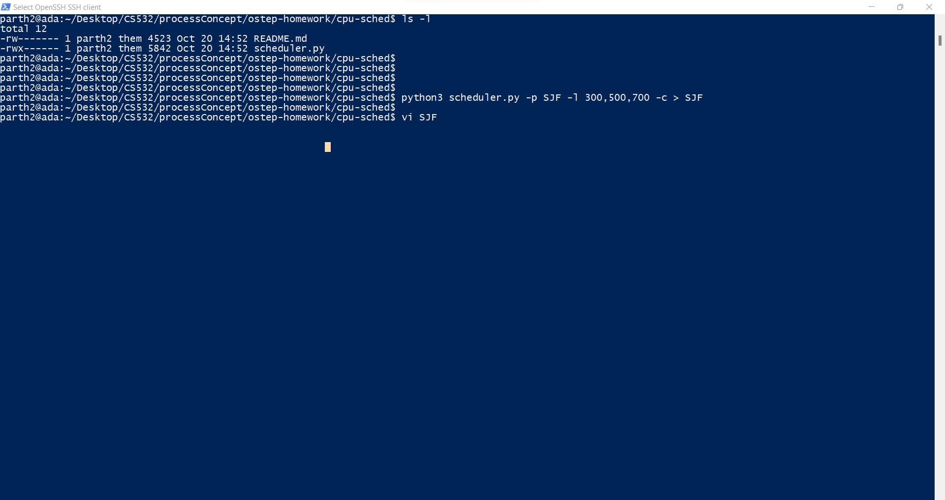

Slide 41
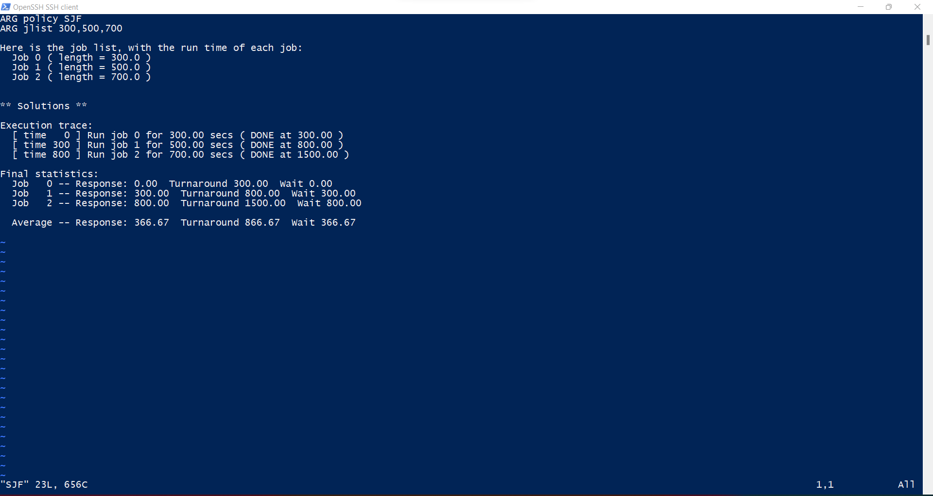

Slide 42
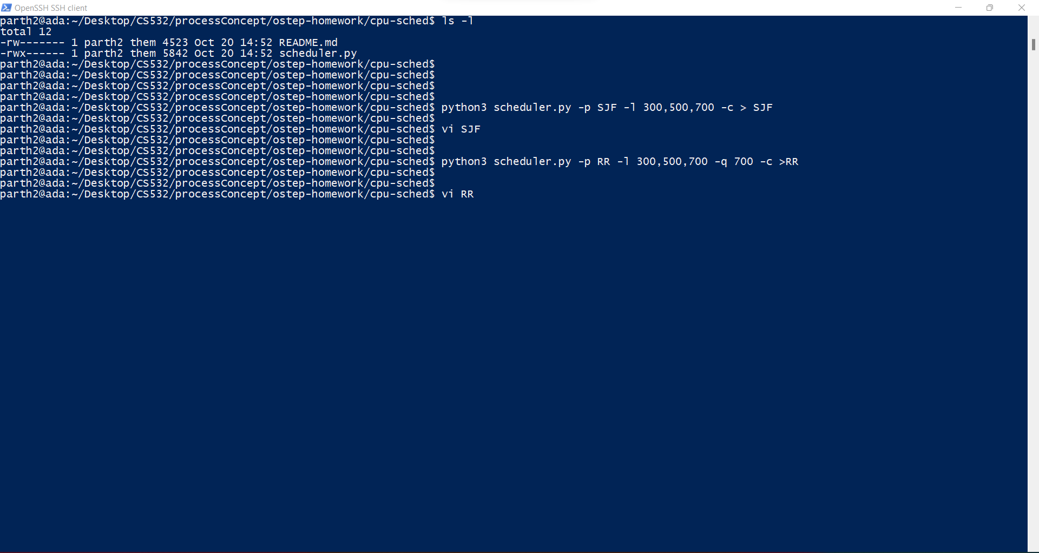

Slide 43
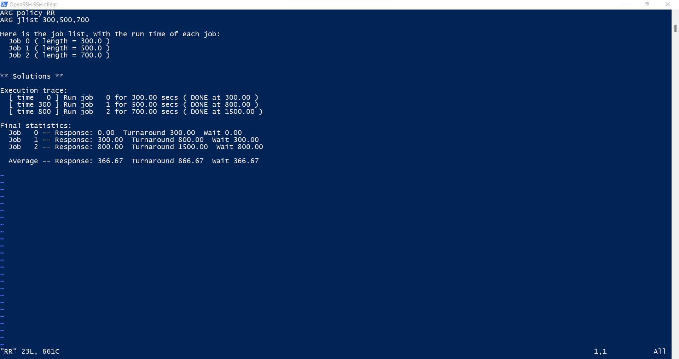

Slide 44
For SJF scheduling algorithm: -
python3 scheduler.py -p RR -l 300,500,700 -c > SJF
Process id | Delay (Wait time) | Response Time | Turnaround time
Process 1 | 0 | 0 | 300
Process 2 | 300 | 300 | 800
Process 3 | 800 | 800 | 1500
For RR Scheduling algorithm: -
python3 scheduler.py -p RR -l 300,500,700 -q 700 -c >RR
Process id | Delay (Wait time) | Response Time | Turnaround time
Process 1 | 0 | 0 | 300
Process 2 | 300 | 300 | 800
Process 3 | 800 | 800 | 1500

Slide 45
6. What happens to response time with SJF as job lengths increase? Can you use scheduler.py to demonstrate the trend?
When using SJF, when we increase the job lengths, then the average response time also increases.
This can be explained as below: -
If the jobs are in the increasing order of their job times, then the nth job’s response time will be equal to the sum of the total execution times of the previous n-1 jobs plus that of the current job time.
This means that increasing the job lengths will increase the average response time for the execution of the processes.

Slide 46
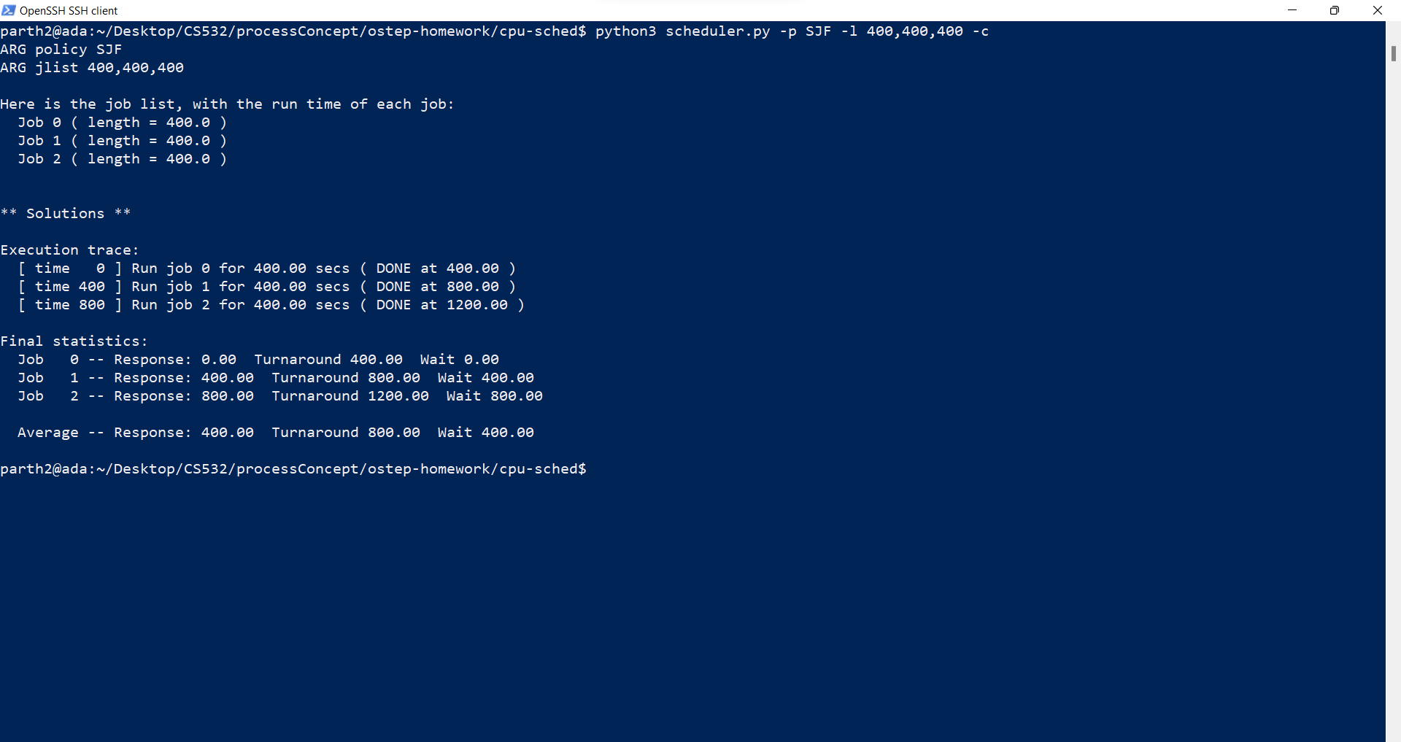
(Experiment 1) When the job lengths are equal: -

Slide 47
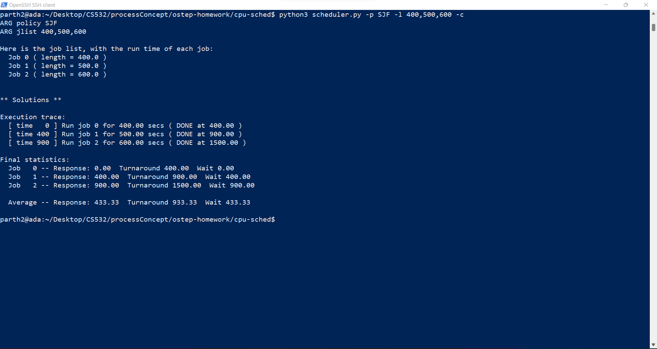
(Experiment 2) When job lengths are increased by 100 instructions per job.

Slide 48
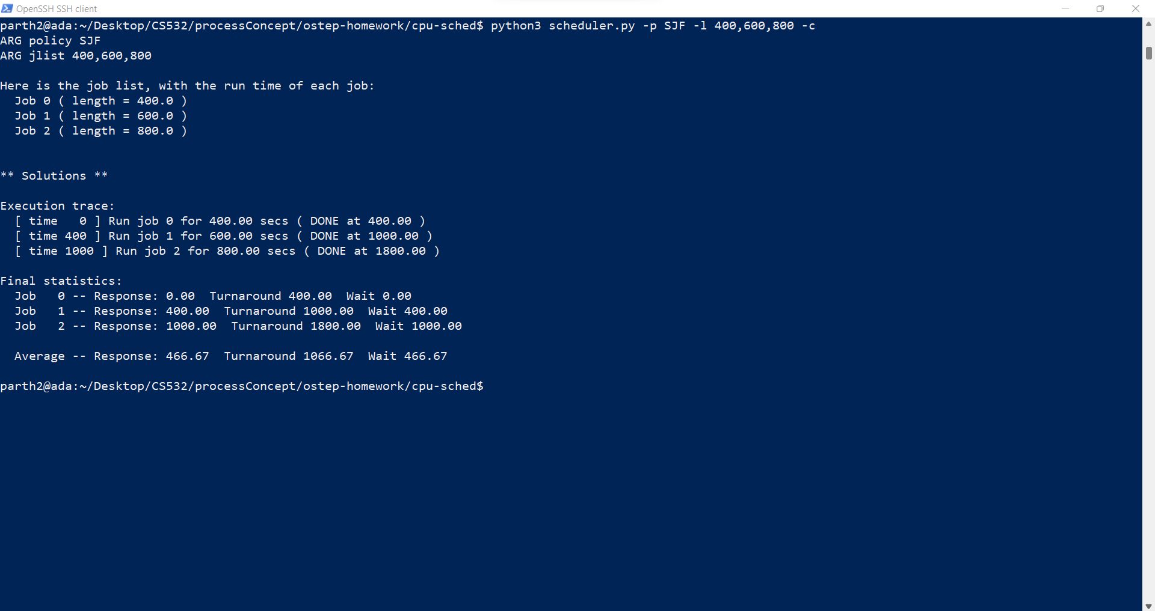
(Experiment 3) When the job lengths are increased by 200 per next instructions.

Slide 49

(Experiment 4) When the job lengths are increased by a significant amount of unequal lengths.

Slide 50
For SJF scheduling algorithm with equal job lengths: -
python3 scheduler.py -p SJF -l 400,400,400 -c
Process id | Delay (Wait time) | Response Time | Turnaround time
Process 1 | 0 | 0 | 400
Process 2 | 400 | 400 | 800
Process 3 | 800 | 800 | 1200
For SJF Scheduling algorithm with an increase of 100 length per job: -
python3 scheduler.py -p SJF -l 400,500,600 -c
Process id | Delay (Wait time) | Response Time | Turnaround time
Process 1 | 0 | 0 | 400
Process 2 | 400 | 400 | 900
Process 3 | 900 | 900 | 1500

Slide 51
For SJF scheduling algorithm: -
python3 scheduler.py -p SJF -l 400,600,800 -c
Process id | Delay (Wait time) | Response Time | Turnaround time
Process 1 | 0 | 0 | 400
Process 2 | 400 | 400 | 1000
Process 3 | 1000 | 1000 | 1800
For SJF Scheduling algorithm: -
python3 scheduler.py -p SJF -l 400,1000,2000 -c
Process id | Delay (Wait time) | Response Time | Turnaround time
Process 1 | 0 | 0 | 400
Process 2 | 400 | 400 | 1400
Process 3 | 1400 | 1400 | 3400

Slide 52
When we compare the average response times for these 4 experiments, we get the following results.
 | Average Wait Time | Average Response Time | Average Turnaround Time
Experiment 1 | 400 | 400 | 800
Experiment 2 | 433.33 | 433.33 | 933.33
Experiment 3 | 466.67 | 466.67 | 1066.67
Experiment 4 | 600 | 600 | 1733.33
As we can see that as the length of the jobs increase, the Average Response time also starts increasing. (Highlighted in red)

Slide 53
7. What happens to response time with RR as quantum lengths increase?
Provide an equation that gives the worst-case response time, given N jobs.

Slide 54
In RR scheduling algorithm, as the quantum lengths increase, then the response times increase.
This is because , in the worst case scenario, the time a process must wait for the its next time slice is directly proportional to the number of other processes and thus the maximum time they can execute.
For deriving a equation for the worst case scenario,
Let the total processes be n
Let the quantum time size of m, then the process will have to wait for m(n-1) to respond to a request in the worst case scenario.
This can be explained by the screenshots on the next page.

Slide 55
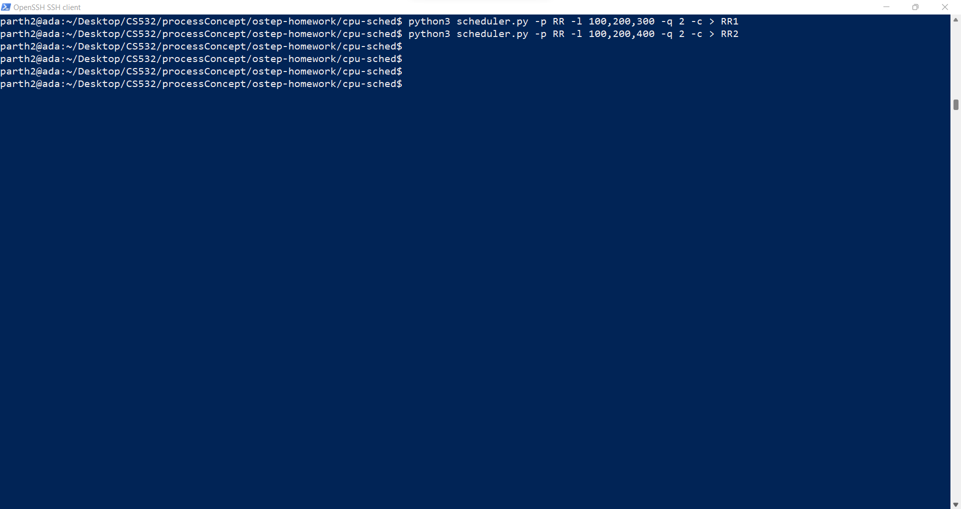

Slide 56
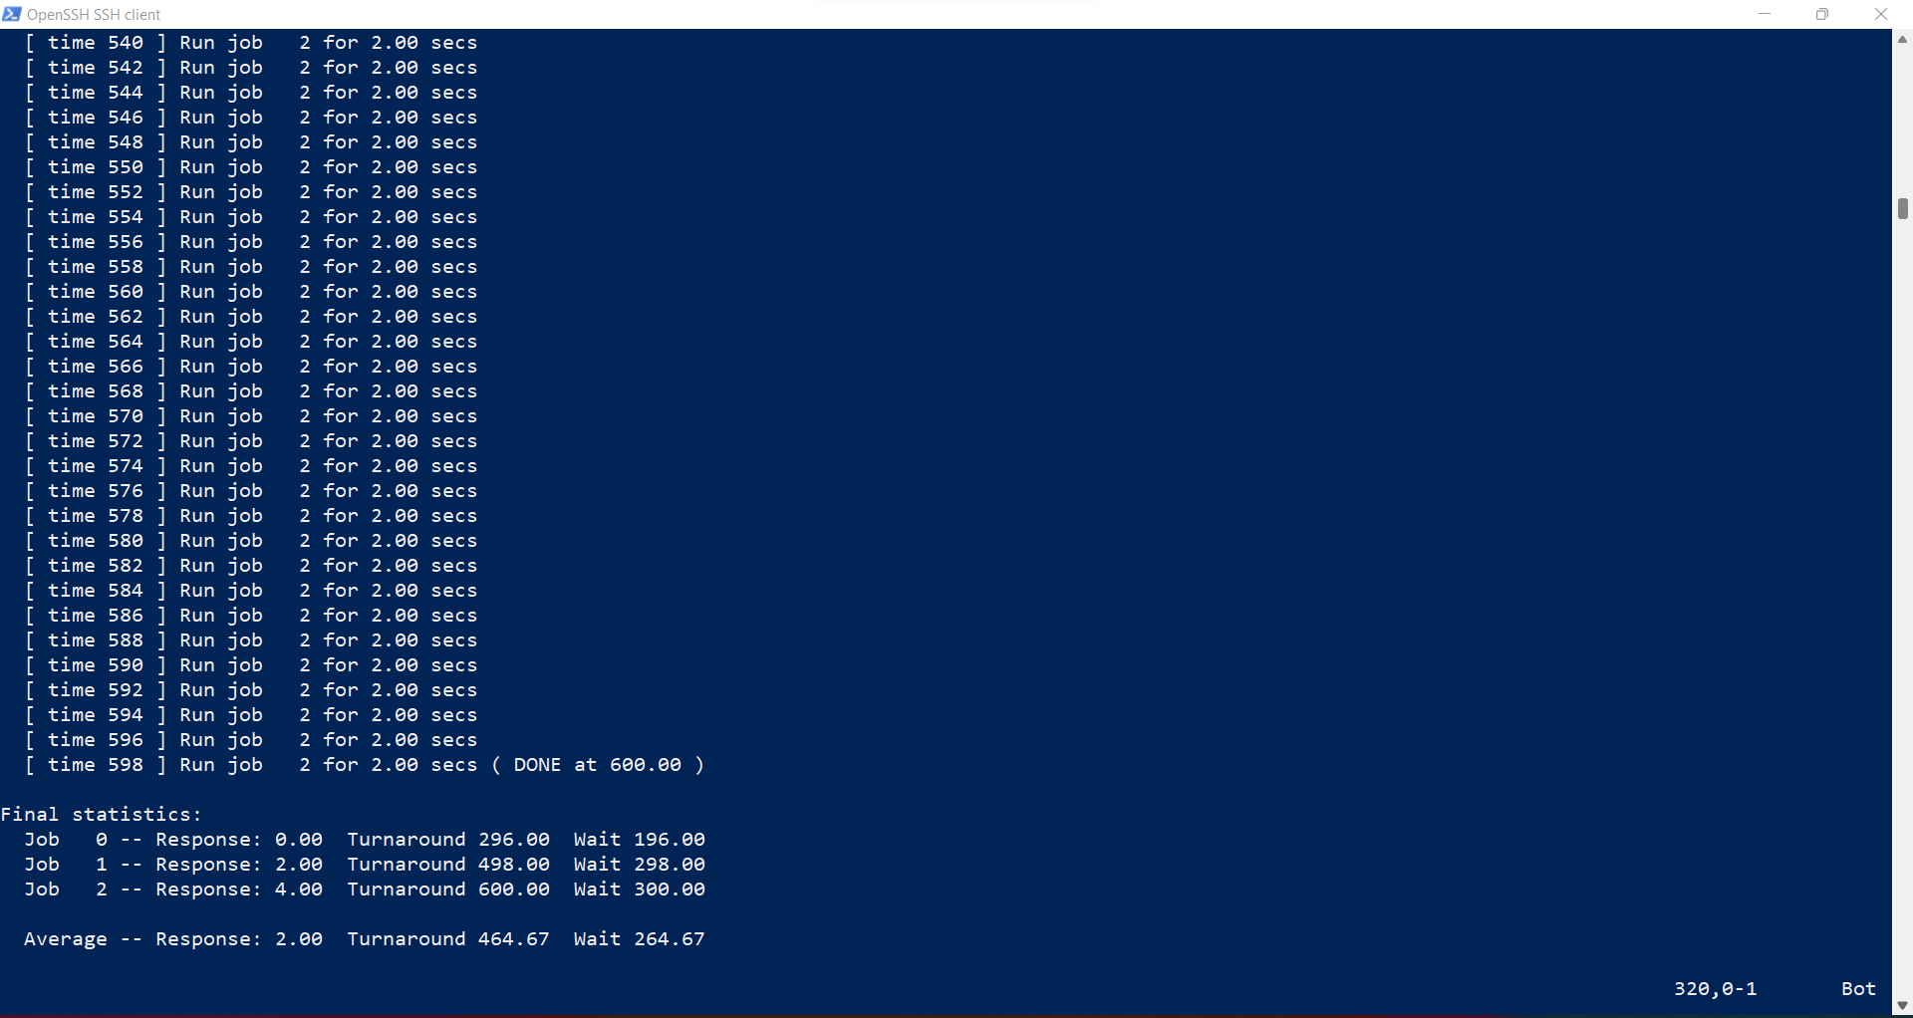

Slide 57


